Slide 1
SWE30003
Software Architectures and Design
Lecture 7
Patterns in Software Development
Notes:
SWE30003 Software Architectures and Design
S1 2023
© Swinburne University of Technology

Slide 2
Logistical matters
Weekly submissions – A & Q
  Week 2: 104 & 101 out of 119;
  Week 3: 101 & 98 out of 118;
  Week 4: 102 & 101 out of 118;
  Week 5: 98 & 98 out of 118;
  Week 6: 88 & 84 out of 117;
  Week 7: 108 & 104 out of 117;
  This is a hurdle requirement, no late submission
Notes:
SWE30003 Software Architectures and Design
S1 2023
© Swinburne University of Technology

Slide 3
Question to Answer – week 6
Consider the situation of designing a Chess application. Would you model a Queen to be a multiple heir of Rook and Bishop? If so, why? If not, why not and how would you model the commonalities of Queen, Rook and Bishop? Which heuristic(s) can help you in making a decision?
Notes:
SWE30003 - Software Architectures and Design
S1 2023
© Swinburne University of Technology
chessPiece hierarchy, and use/refer move/behaviour hierarchy (select relevant) – strategy pattern in later slides.

Slide 4

Outline
What are Patterns?
Idioms
  Delegation and Interface
Design Patterns — GOF format
  Detailed example: Template Method
  Common patterns: Factory Method, Strategy, Composite, Observer, Null Object, Singleton, Command
Other kinds of Patterns
  Pattern systems
Notes:
SWE30003 Software Architectures and Design
S1 2023
© Swinburne University of Technology

Slide 5
Principal References
Erich Gamma, Richard Helm, Ralph Johnson, John Vlissides, Design Patterns, Addison-Wesley, 1995.
Frank Buschmann, Regine Meunier, Hans Rohnert, Peter Sommerlad, and Michael Stal, Pattern-Oriented Software Architecture: A System of Patterns, Addison-Wesley, 1996.
Notes:
SWE30003 Software Architectures and Design
S1 2023
© Swinburne University of Technology

Slide 6
Problem solving is pattern matching!
Notes:
SWE30003 Software Architectures and Design
S1 2023
© Swinburne University of Technology

Slide 7
Outline
What are Patterns?
Idioms
  Delegation and Interface
Design Patterns — GOF format
  Detailed example: Template Method
  Common patterns: Factory Method, Strategy, Composite, Observer, Null Object, Singleton, Command
Other kinds of Patterns
  Pattern systems
Notes:
SWE30003 Software Architectures and Design
S1 2023
© Swinburne University of Technology

Slide 8
What are Patterns?
Patterns were first systematically catalogued in the domain of (building) architecture:
“Each pattern describes a problem which occurs over and over again in our environment, and then describes the core of the solution to that problem, in such a way that you can use this solution a million times over, without ever doing it the same way twice.”
— Alexander et al., A Pattern Language, 1977
Notes:
SWE30003 Software Architectures and Design
S1 2023
© Swinburne University of Technology

Slide 9
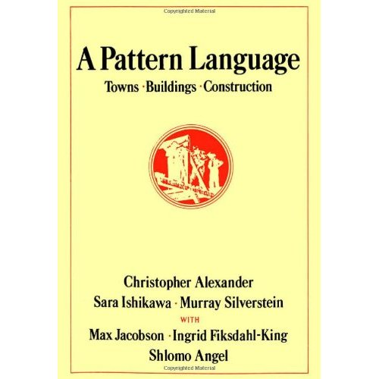
A Pattern Language
The “original” book about the idea of using a generic solution/scheme to a reoccurring problem in the design of artifacts.
Notes:
SWE30003 Software Architectures and Design
S1 2023
© Swinburne University of Technology

Slide 10
(Software) Design Patterns
Design patterns document standard solutions to common (software) design problems:
“Each pattern systematically names, explains, and evaluates an important and recurring design in object-oriented systems. Our goal is to capture design experience in a form that people can use effectively.”
— Gamma et al., Design Patterns, 1995
Notes:
SWE30003 Software Architectures and Design
S1 2023
© Swinburne University of Technology

Slide 11
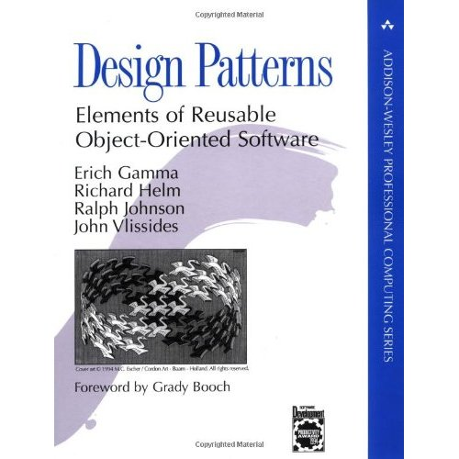
Design Patterns (cont.)
Seminal book that describes the notion of patterns in the context of object-oriented design
A MUST book for a software designer!
Notes:
SWE30003 Software Architectures and Design
S1 2023
© Swinburne University of Technology

Slide 12
What Design Patterns are not…
Algorithms are not software design patterns:
algorithms solve computation problems, not design problems,
merge-sort is an algorithm; divide and conquer is a (design) pattern.
Software components are not software design patterns:
design patterns describe a way of solving a problem,
design patterns document pros and cons of different implementations,
software components are specific implementations, and may be implemented using design patterns.
Type (vs-instances) vs. “entities”
Notes:
SWE30003 Software Architectures and Design
S1 2023
© Swinburne University of Technology

Slide 13
What Design Patterns are not (cont.)
Frameworks are not software design patterns:
a framework implements a generic software architecture,
a design pattern documents the solution to a specific design problem,
a framework may use and be documented with design patterns,
like frameworks, design patterns are drawn from experience with multiple applications solving related problems.
Notes:
SWE30003 Software Architectures and Design
S1 2023
© Swinburne University of Technology
Frameworks are the topic of the next lecture…

Slide 14
What Problems do Patterns solve?
Software design patterns document design experience:
Patterns enable widespread reuse of software structures,
Patterns improve communication within and across software development teams,
Patterns explicitly capture knowledge that experienced developers already understand implicitly,
Useful patterns arise from practical experience,
Patterns facilitate training of new developers,
Patterns help to transcend “programming language-centric” viewpoints.
— Doug Schmidt, CACM, Oct. 1995
Notes:
SWE30003 Software Architectures and Design
S1 2023
© Swinburne University of Technology

Slide 15
What are Idioms and Patterns?
Idioms | Idioms are common programming techniques and conventions. They are often language-specific.
Patterns | Patterns document common solutions to design problems. They are language-independent.
Libraries | Libraries are collections of functions, procedures or other software abstractions that can be used in many applications.
Frameworks | Frameworks are open libraries that define the generic architecture of an application, and can be extended by adding or deriving new classes.
Frameworks typically make use of common idioms and patterns.
Notes:
SWE30003 Software Architectures and Design
S1 2023
© Swinburne University of Technology

Slide 16
Frameworks vs. Libraries
In traditional application architectures, user code makes use of library functionality in the form of procedures or classes:
User Application
main()
Library classes
A framework reverses the usual relationship between generic and application code. Frameworks provide both generic functionality and application architecture:
Framework classes
main()
User classes
Essentially, a framework says: “Don’t call me — I’ll call you.”
Notes:
SWE30003 Software Architectures and Design
S1 2023
© Swinburne University of Technology
It is worth noting here that the last statement is often referred to as the “Hollywood Principle”…

Slide 17
Outline
What are Patterns?
Idioms
  Delegation and Interface
Design Patterns — GOF format
  Detailed example: Template Method
  Common patterns: Factory Method, Strategy, Composite, Observer, Null Object, Singleton, Command
Other kinds of Patterns
  Pattern systems
Notes:
SWE30003 Software Architectures and Design
S1 2023
© Swinburne University of Technology

Slide 18
Idioms
“An idiom is a low-level pattern specific to a programming language. An idiom describes how to implement particular aspects of components or the relationships between them using the features of the given language.”
— Buschmann et al, Pattern-Oriented Software Architecture, 1995
For a collection of sample idioms: have a look at:
James O. Coplien, Advanced C++: Programming Styles and Idioms, Addison-Wesley, 1992
Notes:
SWE30003 Software Architectures and Design
S1 2023
© Swinburne University of Technology

Slide 19
Idiom: Delegation
Problem: How can an object share behavior without inheritance?
Solution: Delegate some of its work to another object
  Inheritance is a common way to extend the behavior of a class, but can be an inappropriate way to combine features.
  Delegation reinforces encapsulation by keeping roles and responsibilities distinct.
Notes:
SWE30003 Software Architectures and Design
S1 2023
© Swinburne University of Technology

Slide 20
Delegation
Example
When a ChessBoard is asked to undo a move, it delegates the work to the corresponding Move object.
Consequences
More flexible, less structured than inheritance.
Delegation is one of the most basic object-oriented idioms, and is used by almost all design patterns.
Notes:
SWE30003 Software Architectures and Design
S1 2023
© Swinburne University of Technology

Slide 21
Delegation example
public class ChessBoard {
...
public void undoMove() {
if (!(this.moves.isEmpty())) {
Move lastMove = this.moves.lastElement();
lastMove.undo (this);
this.moves.removeElement(lastMove);
}
}
}
NOTE: this as parameter to undo!
Notes:
SWE30003 Software Architectures and Design
S1 2023
© Swinburne University of Technology

Slide 22
Idiom: Interface
Problem: How do you keep a client of a service independent of classes that provide the service?
Solution: Have the client use the service through an interface rather than a concrete class.
  If a client names a concrete class as a service provider, then only instances of that class or its subclasses can be used in future.
  By naming an interface, an instance of any class that implements the interface can be used to provide the service.
Notes:
SWE30003 Software Architectures and Design
S1 2023
© Swinburne University of Technology

Slide 23
Interface
Example
Any class that implements the Player interface may be used as valid chess player.
Consequences
Interfaces reduce coupling between classes.
They also increase complexity by adding indirection.
Notes:
SWE30003 Software Architectures and Design
S1 2023
© Swinburne University of Technology

Slide 24
Outline
What are Patterns?
Idioms
  Delegation and Interface
Design Patterns — GOF format
  Detailed example: Template Method
  Common patterns: Factory Method, Strategy, Composite, Observer, Null Object, Singleton, Command
Other kinds of Patterns
  Pattern systems
Notes:
SWE30003 Software Architectures and Design
S1 2023
© Swinburne University of Technology

Slide 25
Design Patterns
“A design pattern provides a scheme for refining the subsystems or components of a software system, or the relationships between them. It describes a commonly-recurring structure of communicating components that solves a general design problem within a particular context.”
— Gamma et al., Design Patterns, 1995
Notes:
SWE30003 Software Architectures and Design
S1 2023
© Swinburne University of Technology
Please note that this definition does not explicitly refer to object-orientation! Hence it could be applied to architectures as well!!

Slide 26
Pattern Format
Pattern Name and Classification: should convey the essence of a pattern
  Also Known As: other common names
The Problem Forces: describes when to apply the pattern
  Intent: short statement of rationale and intended use
  Motivation: a problem scenario and example solution
  Applicability: in which situations can the pattern be applied
— Gamma et al., Design Patterns, 1995
Notes:
SWE30003 Software Architectures and Design
S1 2023
© Swinburne University of Technology
Adopted from GoF

Slide 27
Pattern Format (cont.)
The Solution: abstract description of design elements
  Structure: class and scenario diagrams
  Participants: participating classes/objects and their responsibilities
  Collaborations: how participants carry out responsibilities
The Consequences: results and trade-offs of applying the pattern
  Implementation: pitfalls, hints, techniques, language issues etc.
  Sample Code: illustrative examples in various programming languages
  Known Uses: examples of the pattern found in real systems
  Related Patterns: competing and supporting patterns
— Gamma et al., Design Patterns, 1995
Notes:
SWE30003 Software Architectures and Design
S1 2023
© Swinburne University of Technology

Slide 28
Outline
What are Patterns?
Idioms
  Delegation and Interface
Design Patterns — GOF format
  Detailed example: Template Method
  Common patterns: Factory Method, Strategy, Composite, Observer, Null Object, Singleton, Command
Other kinds of Patterns
  Pattern systems
Notes:
SWE30003 Software Architectures and Design
S1 2023
© Swinburne University of Technology

Slide 29
Pattern: Template Method
(Adapted from Gamma et al., Design Patterns, pp. 325-330)
Name:
Template Method
— Classification: Class Behavioural
Intent:
“Define the skeleton of an algorithm in an operation, deferring some steps to subclasses. Template Method lets subclasses redefine certain steps of an algorithm without changing the algorithm’s structure.”
Notes:
SWE30003 Software Architectures and Design
S1 2023
© Swinburne University of Technology

Slide 30
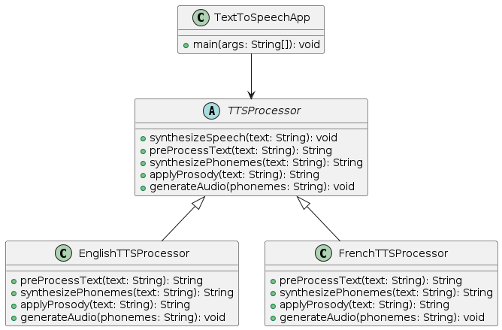
Template Method
public class TextToSpeechApp {
public static void main(String[] args) {
// Select the desired TTS processor based on language
TTSProcessor ttsProcessor = null;
String language = "English"; // or "French"
if (language.equals("English")) {
ttsProcessor = new EnglishTTSProcessor();
} else if (language.equals("French")) {
ttsProcessor = new FrenchTTSProcessor();
} else {
System.out.println("Unsupported language");
return;
}
// Synthesize speech for a given text
String text = "Hello, world!";
ttsProcessor.synthesizeSpeech(text);
}
}

Slide 31
Template Method — Motivation
An application framework provides Application and Document classes. Application is responsible for opening existing documents stored in an external format. An opened document is represented by a Document instance.
An application built with the framework should subclass Application and Document for specific kinds of documents.
Notes:
SWE30003 Software Architectures and Design
S1 2023
© Swinburne University of Technology

Slide 32
Template Method – Motivation (cont.)
Application {abstract}
+AddDocument() +OpenDocument() +CreateDocument () #CanOpenDocument () #AboutToOpenDocument ()
Document {abstract}
+Save() +Open() +Close() +DoRead()
*
docs
empty
MyDocument
+DoRead()
MyApplication
+CreateDocument () #CanOpenDocument () #AboutToOpenDocument ()
return new MyDocument()
Notes:
SWE30003 Software Architectures and Design
S1 2023
© Swinburne University of Technology

Slide 33
Template Method – Motivation (cont.)
The abstract Application class defines the algorithm for opening and reading a document in its OpenDocument operation:
void Application::OpenDocument (const char* name)
{
if (!CanOpenDocument(name)) { // can the document be opened?
return;
}
Document* doc = CreateDocument(name);
if (doc) { // successful creation
_docs->AddDocument(doc);
AboutToOpenDocument(doc); // warn Application subclass instances
doc->Open();
doc->DoRead();
}
}
NOTE: a Document instance reads itself…
Notes:
SWE30003 Software Architectures and Design
S1 2023
© Swinburne University of Technology
Warning: this is C++ code…
NOTE: a Document instance reads itself… a handy “trick” in order to encapsulate the reading of various kinds of documents in the corresponding classes themselves…

Slide 34
Template Method – Motivation (cont.)
OpenDocument is a template method, since it defines an algorithm in terms of abstract operations that subclasses override to provide concrete behaviour.
Subclasses must provide the logic for CanOpenDocument and CreateDocument.
If special actions are needed to prepare for opening documents, they may be specified by overriding AboutToOpenDocument.
Notes:
SWE30003 Software Architectures and Design
S1 2023
© Swinburne University of Technology

Slide 35
Template Method – Applicability
Applicability:
The Template Method should be used:
to implement the non-varying parts of an algorithm once and allow subclasses to implement the parts that may vary.
to refactor common behaviour among subclasses into a common superclass.
  Comment: this is a good example of “refactoring to generalize.”
to control subclass extensions. You can define a template method that calls “hook” operations at specific points, thereby permitting extensions only at those points.
Notes:
SWE30003 Software Architectures and Design
S1 2023
© Swinburne University of Technology

Slide 36
Template Method – Structure
AbstractClass {abstract}
+TemplateMethod() #PrimitiveOperation1() #PrimitiveOperation2()
...
PrimitiveOperation1()
...
PrimitiveOperation2()
...
ConcreteClass
#PrimitiveOperation1() #PrimitiveOperation2()
Notes:
SWE30003 Software Architectures and Design
S1 2023
© Swinburne University of Technology

Slide 37
Template Method – Participants
Participants
AbstractClass (e.g., Application)
  declares abstract primitive operations that concrete subclasses define to implement steps of an algorithm
  defines a template method that implements the skeleton of an algorithm.
  The template method calls the primitive operations as well as operations defined in AbstractClass or elsewhere.
ConcreteClass (e.g., MyApplication)
  implements the primitives operations to carry out subclass-specific steps of the algorithm
Notes:
SWE30003 Software Architectures and Design
S1 2023
© Swinburne University of Technology

Slide 38
Template Method – Collaborations
Collaborations
ConcreteClass relies on AbstractClass to implement the non-varying steps of the algorithm
Notes:
SWE30003 Software Architectures and Design
S1 2023
© Swinburne University of Technology

Slide 39
Template Method – Consequences
Consequences
Template methods are a fundamental technique for factoring out common behaviour in class libraries.
They lead to an inverted control structure since a parent class calls the operations of a subclass and not the other way around.
Notes:
SWE30003 Software Architectures and Design
S1 2023
© Swinburne University of Technology

Slide 40
Template Method – Consequences (II)
Template methods tend to call one of several kinds of operations:
concrete operations (on client classes),
concrete AbstractClass operations,
primitive operations (i.e., declared abstract in AbstractClass),
factory methods (i.e., abstract operations for creating objects),
hook operations that subclasses can extend.
It is important for template methods to specify which operations are hooks (may be overridden) and which are abstract operations (must be overridden).
Notes:
SWE30003 Software Architectures and Design
S1 2023
© Swinburne University of Technology

Slide 41
Template Method – Known Uses
Known Uses
Template methods are so fundamental that they can be found in almost every abstract class.
Related Patterns
Factory Methods are often called by template methods. In the Motivation example, the factory method CreateDocument is called by the template method OpenDocument.
Strategy: Template methods use inheritance to vary part of an algorithm. Strategies use delegation to vary the entire algorithm.
Notes:
SWE30003 Software Architectures and Design
S1 2023
© Swinburne University of Technology
… and now can discuss the benefits of Template Method vs. Strategy…

Slide 42
Outline
What are Patterns?
Idioms
  Delegation and Interface
Design Patterns — GOF format
  Detailed example: Template Method
  Common patterns: Factory Method, Strategy, Composite, Observer, Null Object, Singleton, Command
Other kinds of Patterns
  Pattern systems
Notes:
SWE30003 Software Architectures and Design
S1 2023
© Swinburne University of Technology

Slide 43
Pattern: Factory Method
Problem: How to define an interface to create objects, but defer the decision which specific class to instantiate?
Solution: Introduce a Factory Method in a base class (or interface) and delegate the decision which concrete class(es) to instantiate to subclasses (or implementing classes).
Factory Methods are often used in frameworks to properly encapsulate the instantiation of a derivations of a base abstraction.
Notes:
SWE30003 Software Architectures and Design
S1 2023
© Swinburne University of Technology

Slide 44
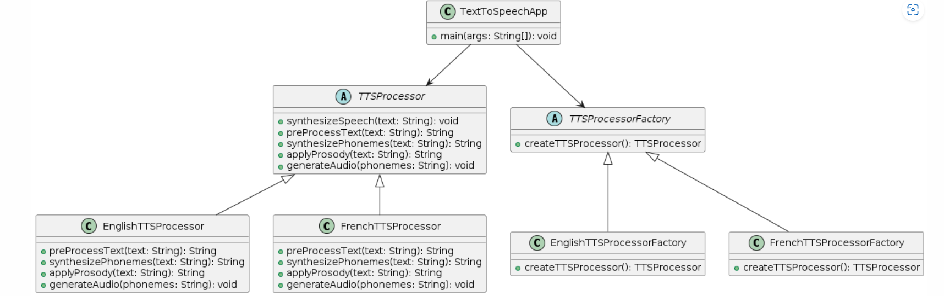
Pattern: Factory Method
Notes:
SWE30003 Software Architectures and Design
S1 2023
© Swinburne University of Technology

Slide 45
Pattern: Factory Method
// Abstract TTSProcessorFactory class
abstract class TTSProcessorFactory {
public abstract TTSProcessor createTTSProcessor();
}
// EnglishTTSProcessorFactory concrete class
class EnglishTTSProcessorFactory extends TTSProcessorFactory {
@Override
public TTSProcessor createTTSProcessor() {
return new EnglishTTSProcessor();
}
}
// FrenchTTSProcessorFactory concrete class
class FrenchTTSProcessorFactory extends TTSProcessorFactory {
@Override
public TTSProcessor createTTSProcessor() {
return new FrenchTTSProcessor();
}
}
// TextToSpeechApp class
public class TextToSpeechApp {
public static void main(String[] args) {
// Select the desired TTS processor factory based on language
TTSProcessorFactory ttsProcessorFactory = null;
String language = "English"; // or "French"
if (language.equals("English")) {
ttsProcessorFactory = new EnglishTTSProcessorFactory();
} else if (language.equals("French")) {
ttsProcessorFactory = new FrenchTTSProcessorFactory();
} else {
System.out.println("Unsupported language");
return;
}
// Create the TTS processor using the factory
TTSProcessor ttsProcessor = ttsProcessorFactory.createTTSProcessor();
// Synthesize speech for a given text
String text = "Hello, world!";
ttsProcessor.synthesizeSpeech(text);
}
}
Notes:
SWE30003 Software Architectures and Design
S1 2023
© Swinburne University of Technology

Slide 46
Factory Method - Chess Example
public abstract class ChessPiece {
...
protected Collection<Behaviour> behaviours = null;
// Constructor
protected ChessPiece(...) {
...
this.behaviours = new HashSet<Behaviour>();
// call a deferred method
this.setBehaviours();
}
}
...
// Instantiations of concrete behaviors is left to subclasses
protected abstract void setBehaviours();
}
Notes:
SWE30003 Software Architectures and Design
S1 2023
© Swinburne University of Technology

Slide 47
Pattern: Strategy
Problem: How to define a family of algorithms and make them interchangeable, independent of clients that may use them?
Solution: Define a common interface for the family of algorithms and have specific implementations implement this interface.
Strategies are used in conjunction with template methods to factor out common behavior of varying algorithms.
Notes:
SWE30003 Software Architectures and Design
S1 2023
© Swinburne University of Technology

Slide 48
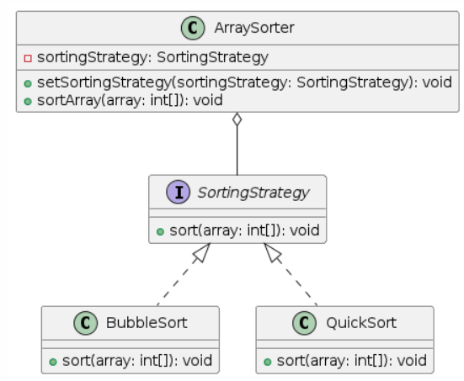
Strategy
// Strategy interface
interface SortingStrategy {
void sort(int[] array);
}
// Concrete strategy: BubbleSort
class BubbleSort implements SortingStrategy {
@Override
public void sort(int[] array) {
System.out.println("Sorting array using Bubble Sort");
// Bubble Sort implementation
}
}
// Concrete strategy: QuickSort
class QuickSort implements SortingStrategy {
@Override
public void sort(int[] array) {
System.out.println("Sorting array using Quick Sort");
// Quick Sort implementation
}
}
Notes:
SWE30003 Software Architectures and Design
S1 2023
© Swinburne University of Technology
Note that this is a simplified version of the two hierarchies.

Slide 49
Usage
// Example usage
public class StrategyPatternExample {
public static void main(String[] args) {
ArraySorter arraySorter = new ArraySorter();
// Use BubbleSort strategy
SortingStrategy bubbleSort = new BubbleSort();
arraySorter.setSortingStrategy(bubbleSort);
int[] array1 = {5, 2, 8, 6, 1};
arraySorter.sortArray(array1);
// Use QuickSort strategy
SortingStrategy quickSort = new QuickSort();
arraySorter.setSortingStrategy(quickSort);
int[] array2 = {9, 4, 7, 3, 10};
arraySorter.sortArray(array2);
}
}
// Context class
class ArraySorter {
private SortingStrategy sortingStrategy;
public void setSortingStrategy(SortingStrategy sortingStrategy) {
this.sortingStrategy = sortingStrategy;
}
public void sortArray(int[] array) {
sortingStrategy.sort(array);
}
}

Slide 50
Strategy - Chess Example
ChessPiece
*
Behaviour
HorizontalBehav.
DiagonalBehav.
VerticalBehav.
Bishop
Queen
Rook
Notes:
SWE30003 Software Architectures and Design
S1 2023
© Swinburne University of Technology
Note that this is a simplified version of the two hierarchies.

Slide 51
Strategy - Chess Example (cont.)
public abstract class ChessPiece {
...
public boolean isValid (Move aMove) {
boolean isValid = false;
ChessPiece destPiece = this.aBoard.getPiece (aMove.getTarget());
if ((destPiece == null) ||
(!(destPiece.getPlayer().equals(this.aPlayer)))) {
for (Behaviour aBehaviour : this.behaviours) {
if (aBehaviour.isValid (aMove, this.aBoard)) {
isValid = true;
break;
}
}
}
return isValid;
}
...
}
Notes:
SWE30003 Software Architectures and Design
S1 2023
© Swinburne University of Technology
NOTE: the ‘isValid’ method is actually implemented in the base class! Subclasses will add their specific behaviours but do not override the base-class method…

Slide 52
Pattern: Composite
Problem: How do you manage a part-whole hierarchy of objects in a consistent way?
Solution: Define a common interface (or abstract base class) that both parts and composites implement (or inherit from).
Typically composite objects will implement their behavior by delegating to their parts.
Notes:
SWE30003 Software Architectures and Design
S1 2023
© Swinburne University of Technology

Slide 53
Composite
Examples
A Java GUI Container is a composite of GUI Components, and also extends Component.
A Group Element contains multiple Drawing Elements (in fact, instances of concrete subclasses thereof)
Consequences
Clients can uniformly manipulate parts and wholes.
In a complex hierarchy, it may not be easy to define a common interface that all classes should implement ...
Notes:
SWE30003 Software Architectures and Design
S1 2023
© Swinburne University of Technology

Slide 54
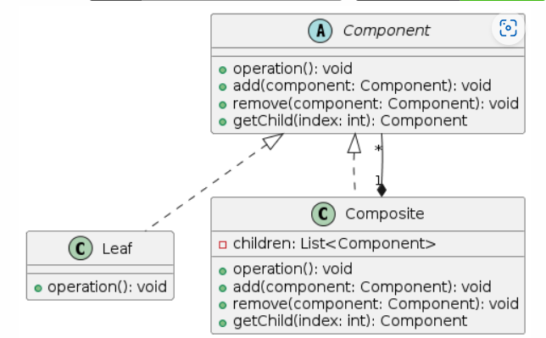
Composite
// Component interface
interface Component {
void operation();
}
// Leaf class
class Leaf implements Component {
private String name;
public Leaf(String name) {
this.name = name;
}
@Override
public void operation() {
System.out.println("Leaf: " + name + " operation");
}
}
Notes:
SWE30003 Software Architectures and Design
S1 2023
© Swinburne University of Technology

Slide 55
Composite
// Client code
public class CompositePatternExample {
public static void main(String[] args) {
Component leaf1 = new Leaf("Leaf 1");
Component leaf2 = new Leaf("Leaf 2");
Composite composite1 = new Composite() {
@Override
public void operation() {
System.out.println("Custom Composite 1 operation");
super.operation();
}
};
composite1.add(leaf1);
composite1.add(leaf2);
Component leaf3 = new Leaf("Leaf 3");
Composite composite2 = new Composite() {
@Override
public void operation() {
System.out.println("Custom Composite 2 operation");
super.operation();
}
};
composite2.add(leaf3);
composite2.add(composite1);
composite2.operation();
}
}
// Composite class
abstract class Composite implements Component {
private List<Component> children = new ArrayList<>();
public void add(Component component) {
children.add(component);
}
public void remove(Component component) {
children.remove(component);
}
@Override
public void operation() {
System.out.println("Composite operation");
for (Component child : children) {
child.operation();
}
}
}
Notes:
SWE30003 Software Architectures and Design
S1 2023
© Swinburne University of Technology

Slide 56
Composite - Drawing Editor Example
Drawing
Element
*
Text
Element
Linear
Element
Group
Element
Notes:
SWE30003 Software Architectures and Design
S1 2023
© Swinburne University of Technology

Slide 57
Pattern: Observer
Problem: How can an object inform arbitrary clients when it changes state?
Solution: Clients implement a common Observer interface and register with the “observable” object; the object notifies its observers when it changes state.
An observable object publishes state change events to its subscribers, who must implement a common interface for receiving notification.
Notes:
SWE30003 Software Architectures and Design
S1 2023
© Swinburne University of Technology

Slide 58
Pattern: Observer
Problem: How can an object inform arbitrary clients when it changes state?
Solution: Clients implement a common Observer interface and register with the “observable” object; the object notifies its observers when it changes state.
An observable object publishes state change events to its subscribers, who must implement a common interface for receiving notification.
Notes:
SWE30003 Software Architectures and Design
S1 2023
© Swinburne University of Technology

Slide 59
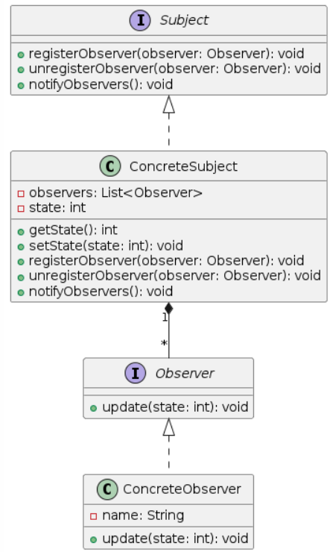
Pattern: Observer
// Subject interface
interface Subject {
void registerObserver(Observer observer);
void unregisterObserver(Observer observer);
void notifyObservers();
}
// Observer interface
interface Observer {
void update(int state);
}
Notes:
SWE30003 Software Architectures and Design
S1 2023
© Swinburne University of Technology

Slide 60
Pattern: Observer
// Concrete subject class
class ConcreteSubject implements Subject {
private List<Observer> observers = new ArrayList<>();
private int state;
public int getState() {
return state;
}
public void setState(int state) {
this.state = state;
notifyObservers();
}
@Override
public void registerObserver(Observer observer) {
observers.add(observer);
}
@Override
public void unregisterObserver(Observer observer) {
observers.remove(observer);
}
@Override
public void notifyObservers() {
for (Observer observer : observers) {
observer.update(state);
}
}
}
// Concrete observer classes
class ConcreteObserver implements Observer {
private String name;
public ConcreteObserver(String name) {
this.name = name;
}
@Override
public void update(int state) {
System.out.println("Observer " + name + " received update. New state: " + state);
}
}
// Client code
public class ObserverPatternExample {
public static void main(String[] args) {
ConcreteSubject subject = new ConcreteSubject();
Observer observer1 = new ConcreteObserver("Observer 1");
Observer observer2 = new ConcreteObserver("Observer 2");
subject.registerObserver(observer1);
subject.registerObserver(observer2);
subject.setState(5);
subject.unregisterObserver(observer2);
subject.setState(10);
}
}
Notes:
SWE30003 Software Architectures and Design
S1 2023
© Swinburne University of Technology

Slide 61
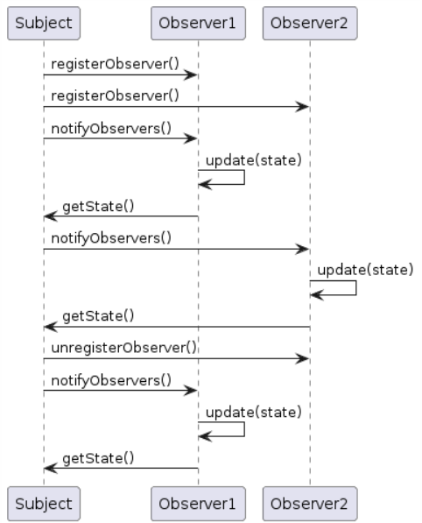
Pattern: Observer
// Concrete observer classes
class ConcreteObserver implements Observer {
private String name;
public ConcreteObserver(String name) {
this.name = name;
}
@Override
public void update(int state) {
System.out.println("Observer " + name + " received update. New state: " + state);
}
}
// Client code
public class ObserverPatternExample {
public static void main(String[] args) {
ConcreteSubject subject = new ConcreteSubject();
Observer observer1 = new ConcreteObserver("Observer 1");
Observer observer2 = new ConcreteObserver("Observer 2");
subject.registerObserver(observer1);
subject.registerObserver(observer2);
subject.setState(5);
subject.unregisterObserver(observer2);
subject.setState(10);
}
}
Notes:
SWE30003 Software Architectures and Design
S1 2023
© Swinburne University of Technology

Slide 62
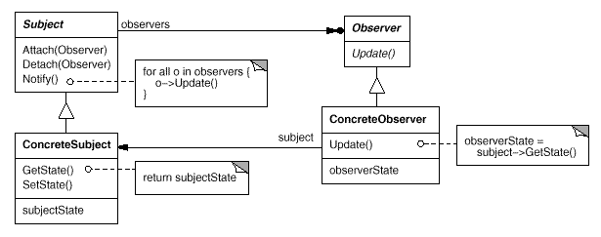
Observer — Structure
Notes:
SWE30003 Software Architectures and Design
S1 2023
© Swinburne University of Technology
Note: this is not UML, but OMT, one of the “predecessors” to UML…
Also, this shows a very interesting interaction pattern that happens quite a lot in object designs.

Slide 63
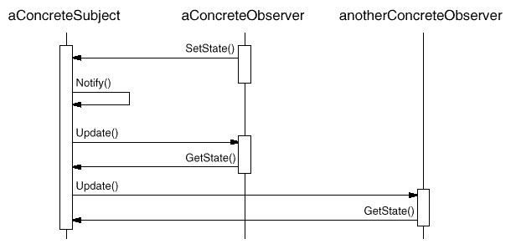
Observer — Collaborations
Notes:
SWE30003 Software Architectures and Design
S1 2023
© Swinburne University of Technology

Slide 64
Observer
Examples
A Button expects its observers to implement the ActionListener interface.
Consequences
Notification can be slow if there are many observers for an observable, or if observers are themselves observable!
Notes:
SWE30003 Software Architectures and Design
S1 2023
© Swinburne University of Technology

Slide 65
Pattern: Null Object
Problem: How do you avoid cluttering your code with tests for null object pointers?
Solution: Introduce a Null Object that implements the interface you expect, but does nothing.
Null Objects may also be Singleton objects, since you never need more than one instance.
Notes:
SWE30003 Software Architectures and Design
S1 2023
© Swinburne University of Technology

Slide 66
Null Object
Examples
NullOutputStream extends OutputStream with an empty write() method
Consequences
Simplifies client code
Not worthwhile if there are only few and localized tests for null pointers
Notes:
SWE30003 Software Architectures and Design
S1 2023
© Swinburne University of Technology

Slide 67
Pattern: Singleton
Problem: How do you ensure that a class has only a single instance and a well-defined access point to it?
Solution: Introduce a Singleton class that keeps track of a static reference to its only instance, and provide a static method to access this sole instance.
Singletons are often used to give controlled access to specific resources (e.g., window manager, print spooler).
  ChessBoard is also a singleton as we will only ever have one board in a chess game.
Notes:
SWE30003 Software Architectures and Design
S1 2023
© Swinburne University of Technology

Slide 68
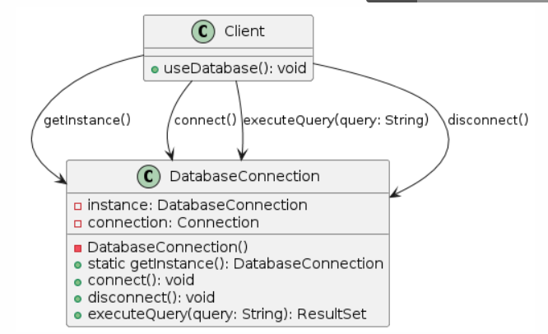
Pattern: Singleton
public class DatabaseConnection {
private static DatabaseConnection instance;
private Connection connection;
private DatabaseConnection() {
// Private constructor to prevent direct instantiation
}
public static DatabaseConnection getInstance() {
if (instance == null) {
instance = new DatabaseConnection();
}
return instance;
}
public void connect(String url, String username, String password) throws SQLException {
if (connection == null || connection.isClosed()) {
connection = DriverManager.getConnection(url, username, password);
System.out.println("Connected to the database.");
}
}
public void disconnect() throws SQLException {
if (connection != null && !connection.isClosed()) {
connection.close();
System.out.println("Disconnected from the database.");
}
}
public ResultSet executeQuery(String query) throws SQLException {
Statement statement = connection.createStatement();
return statement.executeQuery(query);
}
}
Notes:
SWE30003 Software Architectures and Design
S1 2023
© Swinburne University of Technology

Slide 69
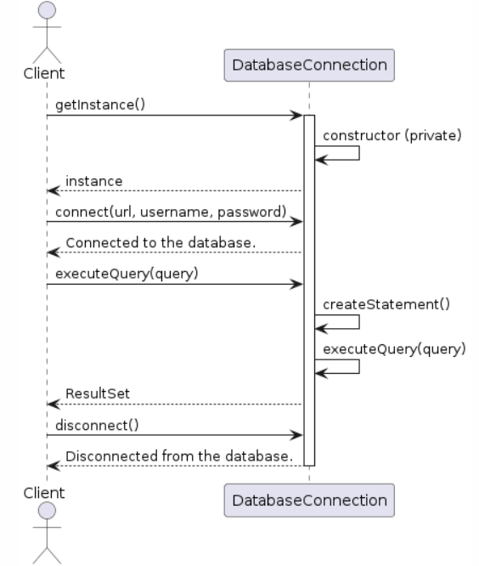
Pattern: Singleton
public class Main {
public static void main(String[] args) {
// Get the singleton instance of DatabaseConnection
DatabaseConnection dbConnection = DatabaseConnection.getInstance();
try {
// Connect to the database
dbConnection.connect("jdbc:mysql://localhost:3306/mydatabase", "username", "password");
// Execute a query
ResultSet resultSet = dbConnection.executeQuery("SELECT * FROM employees");
// Process the query results
while (resultSet.next()) {
String employeeName = resultSet.getString("name");
int employeeAge = resultSet.getInt("age");
System.out.println("Employee: " + employeeName + ", Age: " + employeeAge);
}
// Disconnect from the database
dbConnection.disconnect();
} catch (SQLException e) {
e.printStackTrace();
}
}
}
Notes:
SWE30003 Software Architectures and Design
S1 2023
© Swinburne University of Technology

Slide 70
Singleton - General Structure
public class Singleton {
...
private static Singleton myInstance = null;
protected Singleton() {...}
...
public static Singleton getSingleton() {
if (myInstance == null) {
myInstance = new Singleton();
}
return myInstance;
}
}
Notes:
SWE30003 Software Architectures and Design
S1 2023
© Swinburne University of Technology

Slide 71
Pattern: Command
Problem: How do you let clients to be parameterized with different requests, queue or log requests, and support undoable operations?
Solution: Encapsulate requests in Command objects that can be passed around and executed where (and when) necessary.
Command decouples an object that has to invoke an operation from the specific way how this operation has to be performed.
Notes:
SWE30003 Software Architectures and Design
S1 2023
© Swinburne University of Technology

Slide 72
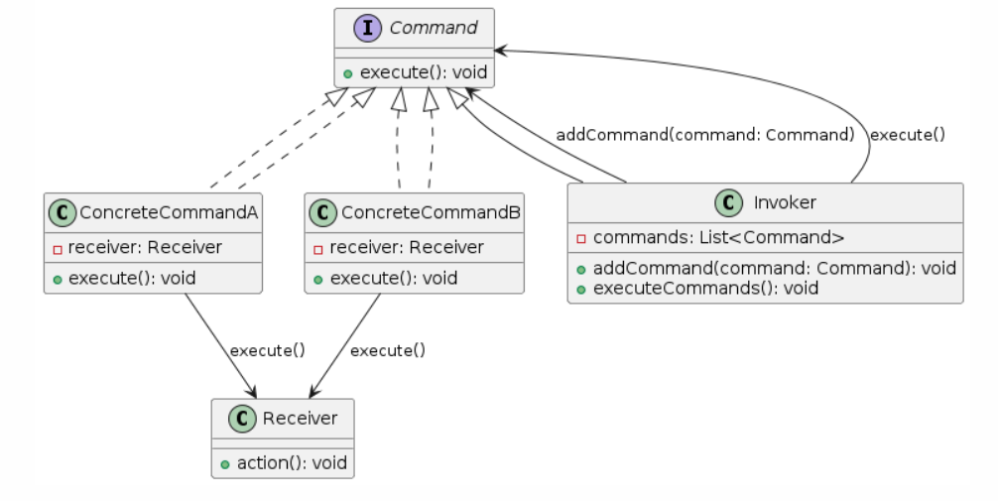
Pattern: Command
Notes:
SWE30003 Software Architectures and Design
S1 2023
© Swinburne University of Technology

Slide 73
Pattern: Command
interface Command {
void execute();
}
class Receiver {
void actionA() {
System.out.println("Receiver: Performing Action A");
}
void actionB() {
System.out.println("Receiver: Performing Action B");
}
}
class ConcreteCommandA implements Command {
private Receiver receiver;
ConcreteCommandA(Receiver receiver) {
this.receiver = receiver;
}
@Override
public void execute() {
receiver.actionA();
}
}
class ConcreteCommandB implements Command {
private Receiver receiver;
ConcreteCommandB(Receiver receiver) {
this.receiver = receiver;
}
@Override
public void execute() {
receiver.actionB();
}
}
class Invoker {
private List<Command> commands = new ArrayList<>();
void addCommand(Command command) {
commands.add(command);
}
void executeCommands() {
for (Command command : commands) {
command.execute();
}
commands.clear();
}
}
public class Main {
public static void main(String[] args) {
Receiver receiver = new Receiver();
Command commandA = new ConcreteCommandA(receiver);
Command commandB = new ConcreteCommandB(receiver);
Invoker invoker = new Invoker();
invoker.addCommand(commandA);
invoker.addCommand(commandB);
invoker.executeCommands();
}
}
Notes:
SWE30003 Software Architectures and Design
S1 2023
© Swinburne University of Technology

Slide 74
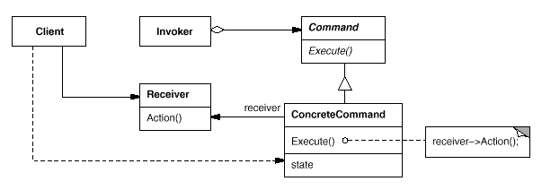
Command - General Structure
Notes:
SWE30003 Software Architectures and Design
S1 2023
© Swinburne University of Technology

Slide 75
Command - Participants
Command
declares an interface for executing an operation.
ConcreteCommand (PasteCommand, OpenCommand)
defines a binding between a Receiver object and an action.
implements Execute by invoking the corresponding operation(s) on Receiver.
Client
creates a ConcreteCommand object and sets its receiver.
Invoker
asks the command to carry out the request.
Receiver
knows how to perform the operations associated with carrying out a request. Any class may serve as a Receiver.
Notes:
SWE30003 Software Architectures and Design
S1 2023
© Swinburne University of Technology

Slide 76
Other Design Patterns
Prototype:
  Specify the kinds of objects to create using a prototypical instance and create new objects by copying this prototype.
Proxy:
  Provide a surrogate or placeholder for another object to control access to it.
Iterator:
  Provide a way to access the elements of an aggregate object sequentially without exposing its underlying representation.
Visitor:
  Represent an operation to be performed on the elements of an object structure without changing the classes of the elements on which it operates.
Notes:
SWE30003 Software Architectures and Design
S1 2023
© Swinburne University of Technology

Slide 77
Outline
What are Patterns?
Idioms
  Delegation and Interface
Design Patterns — GOF format
  Detailed example: Template Method
  Common patterns: Factory Method, Strategy, Composite, Observer, Null Object, Singleton, Command
Other kinds of Patterns
  Pattern systems
Notes:
SWE30003 Software Architectures and Design
S1 2023
© Swinburne University of Technology

Slide 78
Other Patterns
Patterns are not restricted to software designs, they can
be found in many more problem domains:
Reengineering Patterns
Usability Patterns
Documentation Patterns
Organizational Patterns
...
Patterns have to be used with care: “Do not overpattern!”
Notes:
SWE30003 Software Architectures and Design
S1 2023
© Swinburne University of Technology
Mention Erich Gamma’s ECOOP 1997 Keynote address here…

Slide 79
Pattern for writing Abstracts
The abstract of a scientific paper gives an overview of its contents, the problem(s)
it addresses, its contents, the approach taken, outcome, etc. Writing good abstracts
is often an art. The following pattern can help:
Write one sentence about the main problem addressed in the paper.
Write one sentence why the problem stated is a real problem; motivate why dealing with the problem is of interest.
Summarize your approach to solve/address the problem in one sentence.
Finally, give evidence (one to two sentences) why your approach solves/addresses the problem.
Exercise: write an abstract for “Inside Patterns” (recommended reading for this week).

Slide 80
Pattern Systems
Patterns do not exist in isolation:
  they always work together with other patterns.
A plain catalogue of patterns does not reflect all
relationships:
  patterns should be interwoven in pattern systems.
(Note: sometimes Pattern Systems are also referred to as Pattern Languages)
Notes:
SWE30003 Software Architectures and Design
S1 2023
© Swinburne University of Technology

Slide 81
Observer + Layer
The Observer pattern is often used to keep objects in separate Layers independent
GUI layer
click
GUI
notify
update
update
Business layer
notify
Business object
Change state
Notes:
SWE30003 Software Architectures and Design
S1 2023
© Swinburne University of Technology
Please note that we will talk about layering etc. in the next lecture!

Slide 82
Additional Readings about Patterns
Christopher Alexander, et al., A Pattern Language — Towns · Buildings · Construction, Oxford University Press, 1977
David Budgen, Software Design (2nd Edition), chapter 10.
Various articles in Pattern Languages of Program Design Series (published by Addison-Wesley)
Notes:
SWE30003 Software Architectures and Design
S1 2023
© Swinburne University of Technology

Slide 83
Questions for Consideration
The author states that "A pattern provides a generic solution that can be implemented in multiple ways without ever being twice the same". Why can’t software patterns be generalized to a single sample implementation or library for developers to use?
With regards to patterns in software development and their implementation, explain what variations refers to.
What is the difference between a "pattern" and a "framework" and how does this factor into how the software developer implements either of them?
What are some reasons that genericity is considered a good attribute of a Pattern?
Notes:
SWE30003 Software Architectures and Design
S1 2023
© Swinburne University of Technology

Slide 84
Question to Answer
What is the difference between roles and classes in a Design Pattern? Are they the same thing? Pick two design patterns and identify the different classes and roles.
Notes:
SWE30003 Software Architectures and Design
S1 2023
© Swinburne University of Technology

Slide 85
Recommended Reading Week 8
Len Bass, Paul Clements, Rick Kazman, Software Architecture in Practice (Fourth or Third Edition), Chapter 1 (available electronically through Swinburne Library)
OR
Len Bass, Paul Clements, Rick Kazman, Software Architecture in Practice (Second Edition), Chapter 2
(available electronically through Swinburne Library)
Notes:
SWE30003 Software Architectures and Design
S1 2023
© Swinburne University of Technology

